Slide 1
Security and Privacy
Fall 2019
Instructor: Dr. Saeed Samet
School of Computer Science
University of Windsor

Slide 2
Chapter 2
Review of Cryptography
(Hidden Writing)
Notes:
In the last chapter we learned that one important component in any computing system is data. On the other hand, to reach to the computer security goals, we need to have controls on different system components. Therefore, we need to address data controls as one of our main tasks. We also talked about two main approaches for data controls, encryption and anonymization.
In this chapter, we will talk and discuss various ways of cryptosystems as the way to reach to the first approach.
As I also mentioned in the course introduction, we do not have enough time to go to many details for each item. However, as I figure out, not many students in this class are familiar with cryptography. Therefore, we try to go in the middle way, to learn fundamental knowledge of cryptography in this chapter.
OK, as the start point, the word “cryptography” comes from Greek and means Hidden Writing. So we are working to hide the original messages in some ways. However, when we say hiding a message, nowadays, we mean some methods that have mathematical base and some theories behind that. In this way, we are able to formulize the methods as well as measuring the level of security.

Slide 3
Chapter Outline
Review of Cryptography
Terminology
Simple encryption methods
Substitution
Transposition
How encryption can fail
Private-key (Symmetric) encryption
DES and AES
Public-key (Asymmetric) encryption
RSA
Digital signature
Secret Sharing
Notes:
As an outline for the main topics we will discuss in this chapter, we will first bring the terminology and definitions we need during this chapter.
Then we will study some simple and traditional methods for cryptography. We have two purposes for this study. First we learn a history of cryptography from the early ages, which gives us many lessons that we can utilize in our new methods. Second, some of these simple methods are the base and building blocks for modern cryptography. Therefore we should learn these traditional and simple cryptosystems.
Then we talk about some general information and lessons we get from those cryptosystems as well as cryptanalysis. How we can attack to break a cryptosystem. This will give us some way of measurements for weakness and strength of a given cryptosystem.
Then we go to some modern cryptography. We categorize it into two main solutions, symmetric and asymmetric, or private-key and public-key encryptions. For each case, we will first talk about its characteristics and then we bring one or more cryptosystems that are currently used in various systems. We will also talk about some applications such as digital signature and secret sharing.

Slide 4
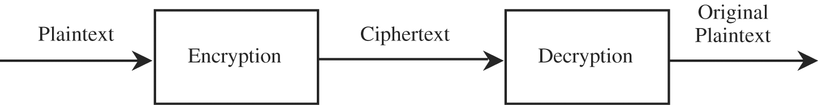
Terminology
Encryption (encode, encipher)
The process of encoding a message so that its meaning is not obvious
Decryption (decode, decipher)
The reverse process, transforming an encrypted message back into its original form
A system for encryption and decryption is called a Cryptosystem.
Notes:
To talk about cryptography, we need an understanding to some terminology and definitions.
Encryption, or encoding or enciphering or simply ciphering, is the process of converting a message to a non-meaningful message such that its meaning is not obvious.
On the other hand, the reverse process is named decryption, or decoding or deciphering, by which an encrypted message will be transformed to the original message.
With encryption and decryption methods, together we create a cryptosystem.
This diagram or data flow shows the process of encryption and decryption in a given cryptosystem.

Slide 5
Terminology (Cont.)
We write c=E(p)and p=D(c)
c represents the ciphertext
E is the encryption rule (algorithm)
p is the plaintext
D is the decryption rule (algorithm)
What we seek is a cryptosystem for which
P = D(E(P))
The encryption and decryption algorithms, often use a (set of) key(s), denoted by K, so that the resulting ciphertext depends on the original plaintext message, the algorithm, and the key value, c=E(K,P).
Notes:
As we usually have a mathematical function for our encryption and decryption, we use the function notation to show these two processes.
…
In every cryptosystem we want to find the original message. So if we apply the decryption on the encryption, we will reach to the original message.
Usually, encryption and decryption use a set of keys. Therefore, the resulting cipher depends on the original message, algorithm and the key value. Therefore, it would be more accurate if we show the encryption as this.

Slide 6
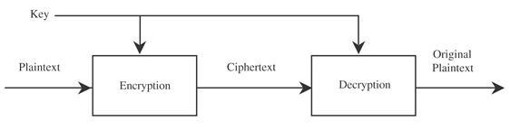
Terminology (Cont.)
If the encryption and decryption keys are the same, Symmetric Encryption, we have
P = D ( K , E ( K , P )
(Using encryption keys, different encryptions can be created from one plaintext)
Notes:
Later on we will see in the modern cryptography that in general we have two types of cryptosystems, symmetric and asymmetric. In symmetric encryption, both encryption and decryption use the same key.

Slide 7
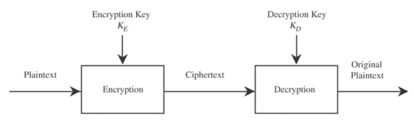
Terminology (Cont.)
If encryption and decryption keys come in pairs, Asymmetric Encryption, then a decryption key, K_{D} , inverts the encryption of key K_{E}
P = D ( K_{D} , E ( K_{E} , P )
Notes:
In asymmetric encryption, encryption key is different from decryption key, and therefore we use subscripts for each key.
Before going further, I just want to bring your attention to one traditional method, called Steganography. As we saw, for any cryptosystem, we can formulize it based on some mathematical methods. Although steganography can be used to hide a message, it cannot be considered as an encryption. There are various ways in this method, such as invisible ink, concealing in an image, pin punctures on selected characters, minute differences between handwritten characters, pencil marks on typewritten characters, … as in this method we conceal the message in a clear sight, it will have different purpose. In encryption, the message is very important. In steganography, although the message is important, however, the both sides, sender and receiver, are also very important to remain unknown to others.

Slide 8
Terminology (Cont.)
Cryptanalyst: a person who studies encryption and ciphertexts to figure out the corresponding plaintexts
Break a single message
Recognize patterns in ciphertexts, to be able to break subsequent ones by applying a decryption algorithm
Infer some meaning without breaking the encryption
Unusual frequency of communication
Determining something by whether the communication was short or long
Deduce the key, to break subsequent ciphers
Find weaknesses in the implementation or environment of use of encryption
Find general weaknesses in an encryption algorithm, without necessarily having intercepted any messages
Notes:
We call person who studies encryption and ciphertexts to figure out the corresponding plaintexts as a cryptanalyst.
A cryptanalyst does the following activities:
Try to break single messages.
Find patterns in the ciphertexts, to find some way to break the cryptosystem using subsequent ciphers
Infer some meaning from the ciphertexts without actually break the system, using some methods such as unusual frequency of communication, as well as the length of the communications.
Find the encryption and decryption keys to break subsequent ciphers.
Find weaknesses of the system implementation.
Find weaknesses of the algorithms, without working on the messages.
We call the techniques in general as cryptanalysis.
We call both cryptography and cryptanalysis as cryptology.

Slide 9
Terminology (Cont.)
Information and tools used by a cryptanalyst
Encrypted messages
Known encryption algorithms
Intercepted plaintext
Data items known or suspected to be in a ciphertext
Mathematical or statistical tools and techniques
Properties of languages
Computers
And of course
Ingenuity
Luck
Notes:
Cryptanalysts can use various tools for their job:
Encrypted messages
Known encryption algorithms
Intercepting the plaintexts
Data items suspected to be in a ciphertext. It could come from the nature of the environment in which messages are being exchanged.
Various mathematical and/or statistical techniques. For instance we will use letter frequency table
Language properties. For instance we use frequent words in any given language.
Computers
Ingenuity. It is especially good for traditional ways as well as for steganography
Luck, same as previous one.

Slide 10
Terminology (Cont.)
Breakable Encryption
Given enough time and data, an analyst can determine the algorithm.
An algorithm that is theoretically breakable may be impractical to try to break
Example:
For a 25-character message, a cipher may have 26²⁵ (approximately 10³⁵) possible decipherments
If a computer performs 10¹⁰ operations per second, it would require 10²⁵ seconds, or roughly 10¹⁷ years
Notes:
When we say an encryption is breakable, it means if a cryptanalyst is given enough time and data, they can determine the algorithm.
However, a cryptosystem, might be impractical to break even if it is breakable.
For instance, a cipher with the length of 25 characters could have 26 to 25 possible decipherments.

Slide 11
Terminology (Cont.)
Breakable Encryption (cont.)
Facts
The cryptanalyst cannot be expected to try only the hard, long way
In the previous example, a better approach requires only 10¹⁵ operations, only one day
Estimates of breakability are based on current technology
Moore’s Law: The speed of processors doubles every 1.5 years (it has been true for over two decades)
Notes:
However, we should know some facts.
First of all, a cryptanalyst cannot be controlled and expected to try long and hard ways.
Speed of processors are growing very fast, so we should have some estimation of breakability based on these growth.
Moore’s law says that the speed of processors will be doubled every 1.5 years, and it has been true estimation over two decades.

Slide 12

Representing Characters
Convention: Plaintext is written in UPPERCASE letters, and ciphertext is in lowercase letters
Encryption algorithms are usually based on mathematical transformations
Arithmetic is performed as if the alphabetic table were circular (modular arithmetic)
Notes:
Through this chapter we will follow a notation convention. We will show the plaintext in Uppercase letters and ciphertext in lowercase letters.
Also encryption algorithms are usually based on mathematical transformations and modular arithmetic. Because we usually working with messages in English language, we transform the letters to 0 to 25 in their alphabetical order, and therefore the modular arithmetic is in Modula 26.

Slide 13
Substitution Ciphers
Mono-alphabetic: fixed substitution over the entire message (Simple substitution)
Caesar cipher (Shifting the alphabet)
Atbash cipher (reversing the alphabet)
Poly-alphabetic: uses a number of substitutions at different positions in the message
Vigenere cipher
Enigma machine
Not secure to use, but good to know and use as some building blocks in other encryption methods
The main goal of substitution is “Confusion”
Notes:
There are many types of traditional ways of encryptions. In general most of them are categorized in two types, substitution and transposition. In substitution one letter is exchanged for another letter, while in transposition the order of the letters is rearranged.
As I have already mentioned, we want to study these cryptosystems as they are the base of modern cryptography techniques. We learn these encryptions, their strengths and weaknesses. Then we see how we can use them to establish a better and stronger set of cryptosystems.
We will start by substitution ciphers.
There are two general type of substitution cipher. The first one is mono-alphabetic in which a fixed substitution will be applied over the entire message, which is a simple substitution. We will see some examples like Caesar ciphers by shifting the alphabet letters and Atbash cipher by reversing the alphabet letters.
The second type of substitution cipher is poly-alphabetic, in which we use a number of substitutions at different positions in a given message. It is more complex than the mono-alphabetic type. We will work on some of cryptosystems in this type such as vigenere cipher and enigma machine.
After talking about these cryptosystems, we will analyze their security to see how strong they could be. We will se that they are not very secure, but we can see them as some building blocks.
In general, the main objective in substitution cipher is confusion. We will define this term later, but in short, the main purpose is to create a complex relation between the plaintext and ciphertext.

Slide 14
Substitution Ciphers (cont.)
Caesar cipher
Each letter is translated to the letter a fixed number of places after it in the alphabet.
It uses a shift of 3, so plaintext letter p_{i} is enciphered as ciphertext letter c_{i} by the rule
c_{i}=E(p_{i})=p_{i}+3
Example
C A E S A R C I P H E R
f d h v d u f l s k h u
Notes:
OK, let start the mono-alphabetic substitution cipher with shift cipher, and especially Caesar cipher which has been named from Julius Caesar, who is believed as the first person used the substitution cipher. In general shift cipher translates each letter to the letter with a fixed number of places after it inside the alphabet. In Caesar cipher, the shift value is 3. so this means that we substitute letter A with d, B with e and so on. When we reach to the letter X, we do same as the modular arithmetic, so X will be substituted with a, Y with b and finally Z with c.
Therefore, we can write the encryption as an equation like this.
This is an example, in which we encrypt CAESAR CIPHER to this using this substitution cipher.

Slide 15
Substitution Ciphers (cont.)
Caesar cipher
Advantage and Disadvantage
Simplicity
A small piece of ciphertext is enough to predict the entire pattern of the encryption
Cryptanalysis
Allowing blank to be translated to itself
Substitute known short words at appropriate places
Substituting for matching characters at other places
Guess at three-letter words
Guess unused letters
…
hfjxfw hnumjw nx ytt xnruqj yt zxj
CAESAR CIPHER IS TOO SIMPLE TO USE
http://scottbryce.com/cryptograms/stats.htm
https://www.mtholyoke.edu/courses/quenell/s2003/ma139/js/count.html
Notes:
Now let see what would be the advantages and disadvantages of this encryption system.
In one hand, it is very simple and easy to understand. However, on the other hand it is very simple to break as well. We just need a small piece of ciphertext to predict the entire pattern of the encryption.
Now let see how we can do cryptanalysis for shift cipher.
First of all, when we allow blank to be translated to itself, it gives a strong clue to the attackers.
Second, we can easily figure out the short words.
Then we can substitute same characters in other places.
We can also guess the three-letter words.
Then by deleting the already found letters from the alphabet, we can guess unused letters easily.
Lets try the following example using some info from the following website.
Ok, lets think about number of possible keys in shift cipher. 25
So it means the shift cipher is very far from secure.

Slide 16
Substitution Ciphers (cont.)
Complexity
Encryption and decryption with substitution ciphers can be performed by direct lookup in a table illustrating the correspondence
Transforming a single character can be done in a constant amount of time
Complexity of the algorithm to encrypt a message of n characters is proportional to n
Notes:
In terms of the complexity of substitution cipher, we can say that
First of all, encryption and decryption can be done by direct lookup in a table of letters and their correspondence
The transformation can be done in constant time
And therefore, the complexity of an algorithm to encrypt a message with n characters is proportional to n

Slide 17
Substitution Ciphers (cont.)
Cryptanalysis
Guess
Strategy
Mathematical skills
Language word patterns
Short words
Words with repeated patterns
Common initial and final letters
Letters frequency (Frequency Distribution Analysis)
Context of the text
Notes:
If we want to summarize the possible ways for breaking this types of cryptosystems, we can list them as follows
By guess
We should have some strategy and steps
We sometimes need some simple mathematical skills
Patterns in the language are very important and informative to break a cipher such as frequent short words, words with some repeated patterns, like too, been, meet, seen, … and also some common initial and final letters and words.
The best tool is the letter frequency table in the host language, as well as digrams, trigrams, …
And of course it would be very helpful if we have some ideas about the message context

Slide 18
Cryptographer’s Dilemma
An encryption based on a hard problem is not secure just because of the difficulty of the problem.
Short messages give the cryptanalyst little to work with, so short messages are fairly secure with even simple encryption.
An encryption algorithm must be regular for it to be algorithmic and for cryptographers to be able to remember it.
A security measure must be strong enough to keep out the attacker only for the life of the data. Data with a short time value can be protected with simple measures.
Notes:
Before continuing, it would be better to have some general cryptographer’s dilemma
First of all, if a cryptosystem is based on a hard problem, it does not necessary mean that it is secure
Short messages give little info to cryptanalysts.
Encryption algorithms should be regular both for implementation purposes as well as cryptographers to formulize and remember them.
The principle of adequate protection

Slide 19
One-Time Pads (Perfect Cipher)
Length of key should be the same as that of the plaintext message
Issues
Synchronization between the sender and receiver
Unlimited number of keys
Perfect Secrecy: Ciphertext gives absolutely no additional information about the plaintext .
Given a truly random key which is used only once, a ciphertext can be translated into any plaintext of the same length, and all are equally likely.
Proved by Claude Shannon using Information Theory
Notes:
Before going to the second type of traditional cryptosystems we little bit talk about a cryptosystem that is able to provide perfect secrecy.
It is called one-time pads. The ideal case is that the length of the key is the same as the length of the message itself.
So, we can imagine what would be the issues even before talking about the cryptosystem itself.
If the key is generated in a true random fashion, then it means that no matter what the plaintext message is, the ciphertext is also a true random sequence. This results that for a ciphertext with length m, any meaningful phrase of length m could be the possible plaintext message with equal probability.

Slide 20
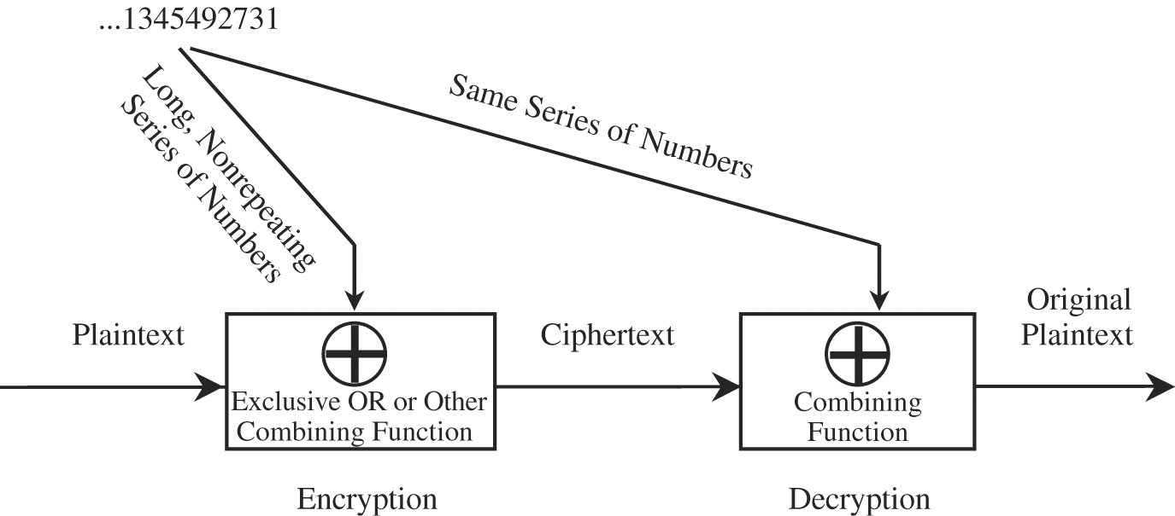
One-Time Pads (cont.)
Vernam Cipher
Notes:
For instance Vernam cipher is a one-time pads cryptosystem, in which we map the letters to their corresponding numbers from 0 to 25. We than use a key sequence and combine with the message to create the ciphertext. Same key sequence is used for decryption.

Slide 21
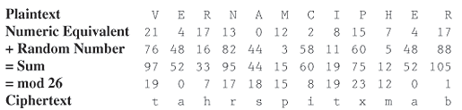
One-Time Pads (cont.)
Example
Duplicate ciphertext letters are generally unrelated.
Notes:
This is an example of one-time pads, in which keys are random two digit numbers. We use addition Modula 26 to find cipher. In this example we see two “a” and two “t” in the cipher. However, they have different situations. Having two “a”s is by accident, because we have same letters at two positions with the same keys. However, the first “t” is the cipher of “V” while the second “t” comes from “I”, which is the main point of this type of cryptosystem.

Slide 22
Transpositions (Permutations)
Permutation
Reordering of the characters of the plaintext
means that A is encrypted into c
One way is to use a key to control the permutation
Example: key = professional
ABCDEFGHIJKLMNOPQRSTUVWXYZ
profesinalbcdghjkmqtuvwxyz
Notes:
We can increase the level of security of shift cipher and make it harder to break by drastically increasing the key space. One way is to do permutation instead of simple shift. Therefore, the possible keys will be increased to ? 26! = 4X10^26.
Let see an example of permutation as the mono-alphabetic substitution cipher.
Homophones is one solution for letter frequency issue, in which number of symbols, which is proportional to the letter frequency, are assigned and randomly selected.
We can also use a keyword arranged by the sender and receiver as the starting point, and then continue the rest of the unused letters in order.
However, if the key word is short, then letters and their corresponding ciphers are very close to each other. Also, many times, some last letters map to themselves.
You can find many types of mono-alphabetic substitution ciphers, and all of them suffer from letter and word frequency attack.
Before going forward, we will see two other types of substitution cipher. In the first one, PlayFair and Hill, we encrypt multiple letters of plaintext. In the second one, Vigenere, we use multiple cipher alphabets.
In poly-alphabetic substitution cipher, a set of related mono-alphabetic substitutions are used, based on the selected key.
There are two types of attack to vigenere cipher. One by using the repeated patterns, and the second is to use the letter frequency table.

Slide 23
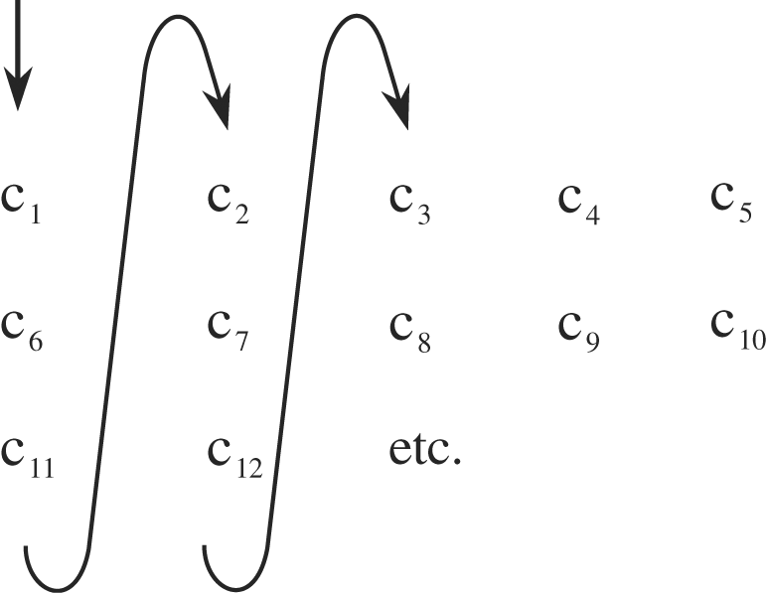
Transpositions (CONT.)
The letters of the message are rearranged
The main goal is “Diffusion”
Widely spreading the information from the message or the key across the ciphertext
Columnar Transpositions
A rearrangement of the characters of the plaintext into columns
Notes:
If we only rearrange the order of letters in the plaintext, than we have transposition cipher.
By doing this, we want to make some sort of diffusion, which means widely spreading the message across the whole ciphertext.
There are many types of transpositions. For instance we can use rail fence by writing the plaintext as a sequence of diagonals and then read it as a sequence of rows.
Another type is the columnar transposition, in which we write the plaintext in a rectangular matrix, row by row, and then read it in columns. We can even set a key as a random order of the columns and then read the columns based on the ascending order of key numbers. Example

Slide 24
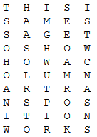

Transpositions (cont.)
Columnar Transpositions (cont.)
Example
THIS IS A MESSAGE TO SHOW HOW A COLUMNAR TRANSPOSITION WORKS
Notes:
What is the key in this transposition?
We can also add column order as extra key

Slide 25
Transpositions (cont.)
Columnar Transpositions (cont.)
Complexity
The time needed to apply the algorithm is proportional to the length of the message
Substitution cipher requires only a constant amount of space (26² locations)
Columnar Transposition requires storage for all characters of the message, so it depends on the length of the message
The delay associated with Columnar Transposition also depends on the length of the message
Difference between Substitution and Transposition
Substitution: each letter retains its position but changes its identity,
Transposition: each letter retains its identity but changes its position.
Notes:
This algorithm is not suitable especially for long messages and when the time is of the essence.

Slide 26
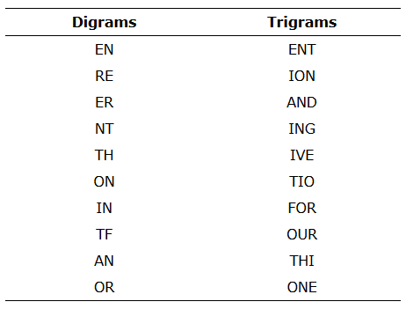
Transpositions (cont.)
Di-grams: pairs of adjacent letters
Tri-grams: groups of three letters
Most Common English Di-grams and Tri-grams
http://scottbryce.com/cryptograms/stats.htm
Notes:
It is also good to indicate the digrams and trigrams that will usually not occur in the host language, such as –vk- or –qp-
Just remember that infrequent sequences could happen in acronyms, foreign words and across word boundaries.

Slide 27
Transpositions (cont.)
Cryptanalysis
Computing the letter frequencies
If all letters appear with their normal frequencies, we can infer that a transposition has been performed
Break the ciphertext into columns
Two different strings of letters can represent di-grams from the plaintext. So
Where does a pair of adjacent columns lie? and
Where are the ends of the columns?
Compare a block of characters (as a moving window) against characters successively farther away in the ciphertext
For each window position, we ask two questions:
Do common di-grams appear?
Do most of the di-grams look reasonable?
When di-grams indicate a possible match for a fragment of ciphertext, the next step is to try to extend the match

Slide 28
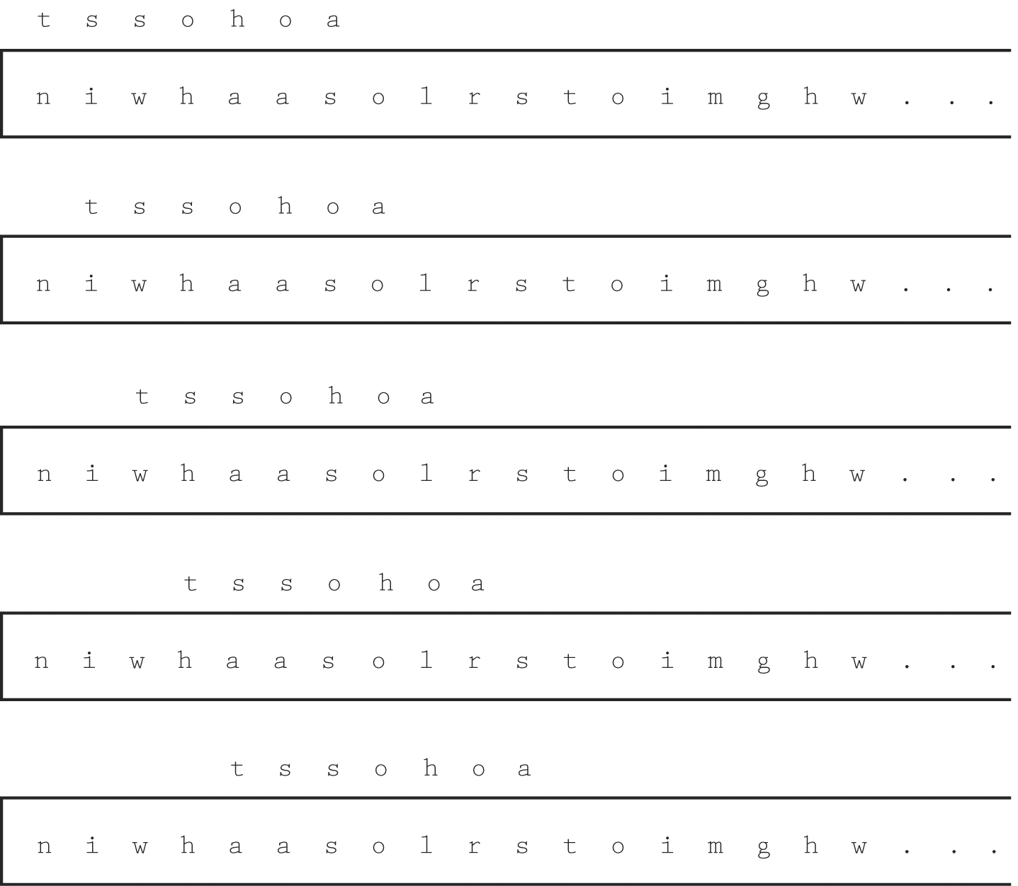
Transpositions (cont.)
Cryptanalysis (cont.)
Example

Slide 29
Combinations of Approaches
Substitution and Transposition can be considered as building blocks for encryption
Other techniques can be based on each of them, both of them, or a combination with another methods
Product Cipher: A combination of two ciphers, typically performed one after another
E₂(E₁(p,k₁),k₂)
Remember the Principle of Weakest Link:
Security can be no stronger than its weakest link.
Two controls are not always better than one, and could be even worse.
Notes:
Now, that we saw these two approaches, substitution and transposition, let us talk little bit about the combination of these approaches.
We will see that we can use them as some building blocks for our modern techniques in cryptosystems.
The combination could be

Slide 30
Good Ciphers
Shannon’s Characteristics of “Good” Ciphers
The amount of secrecy needed should determine the amount of labor appropriate for the encryption and decryption
A reiteration of the principle of timeliness, and the fact that even a simple cipher may be strong enough to deter the casual interceptor or to hold off any interceptor for a short time.
The set of keys and the enciphering algorithm should be free from complexity
We should restrict neither the choice of keys nor the types of plaintext on which the algorithm can work.
The key must be transmitted, stored, and remembered, so it must be short.

Slide 31
Good Ciphers (cont.)
Shannon’s Characteristics of “Good” Ciphers (cont.)
The implementation of the process should be as simple as possible
Errors in ciphering should not propagate and cause corruption of further information in the message
Dropping one letter in a columnar transposition throws off the entire remaining encryption
The size of the ciphertext should be no larger than the text of the original message, otherwise
It gives the cryptanalyst more data from which to infer a pattern.
A longer ciphertext implies more space for storage and more time to communicate.

Slide 32
Trustworthy of Encryption Systems
An encryption is commercial grade or trustworthy by meeting some constraints:
It is based on sound mathematics.
It has been analyzed by competent experts and found to be sound.
It has stood the “test of time.” The flaws in many algorithms are discovered relatively soon after their release.
Three popular cryptosystems in the commercial world
Data Encryption Standard (DES)
Rivest–Shamir–Adelman (RSA)
Advanced Encryption Standard (AES)
DES and RSA meet above criteria
AES meets the first two and is starting to achieve widespread adoption.

Slide 33
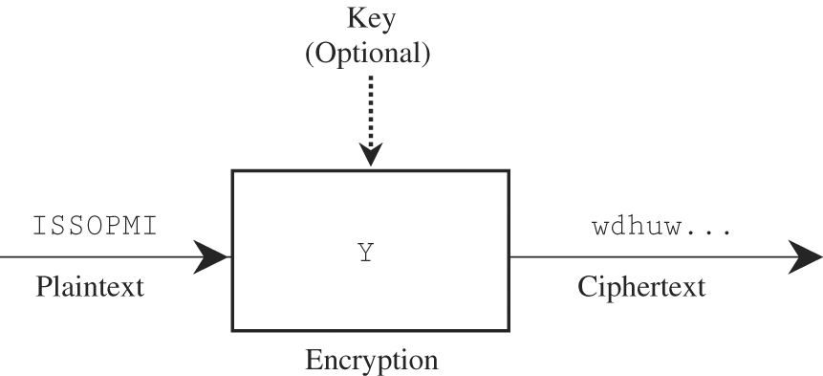
Stream and Block Ciphers
Stream Cipher: Converts one symbol of plaintext immediately into a symbol of ciphertext.
The transformation depends only on the symbol, the key, and the control information of the algorithm.
Skipping a character in the key during encryption, affects the encryption of all future characters.
Receiver can recalibrate the key

Slide 34
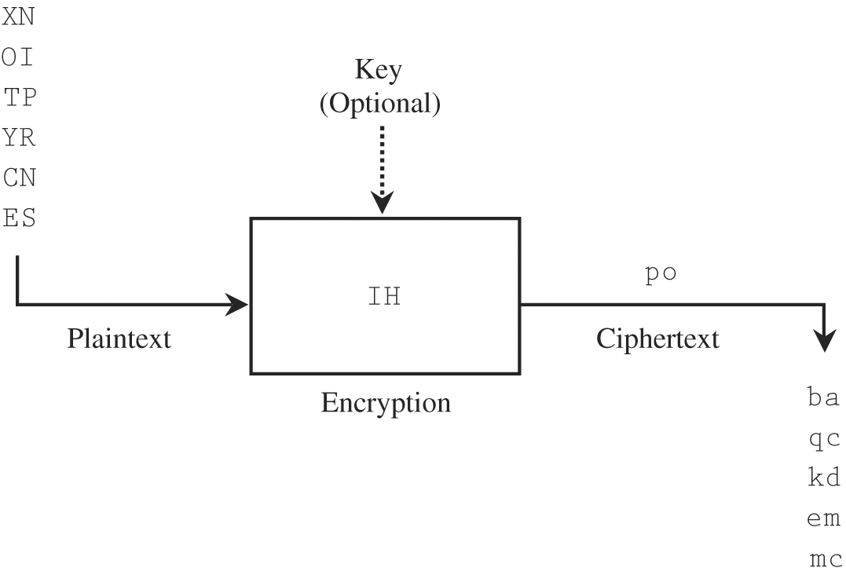
Stream and Block Ciphers (cont.)
Block Cipher: A group of plaintext symbols are encrypted as one block.
It works on blocks of plaintext and produces blocks of ciphertext.

Slide 35
Stream and Block Ciphers (cont.)
Advantages
Stream
Speed of transformation
Low error propagation
Block
High diffusion
Immunity to insertion of symbols
Disadvantages
Stream
Low diffusion
Susceptibility to malicious insertions
Block
Slowness of encryption.
Error propagation

Slide 36
Confusion and Diffusion
Confusion: The interceptor should not be able to predict what will happen to the ciphertext by changing one character in the plaintext.
Caesar cipher is not good for providing confusion
One-time pad provides good confusion
Diffusion: The cipher should also spread the information from the plaintext over the entire ciphertext so that changes in the plaintext affect many parts of the ciphertext.

Slide 37
Cryptanalysis
Four types of information:
Ciphertext
Full Plaintext
Partial Plaintext
Algorithm

Slide 38
Cryptanalysis (cont.)
Five approaches
Ciphertext Only
Analyst had only the ciphertext
The decryption had to be based on probabilities, distributions, and characteristics of the available ciphertext, plus publicly available knowledge

Slide 39
Cryptanalysis (cont.)
Five approaches (cont.)
Full or Partial Plaintext
Analyst have a sample message and its decipherment.
In this case the analyst is attempting to find E (or D) by using a known plaintext attack.

Slide 40
Cryptanalysis (cont.)
Five approaches (cont.)
Ciphertext of any Plaintext
The analyst may have infiltrated the sender’s transmission process so as to be able to cause messages to be encrypted and sent at will. This attack is called a chosen plaintext attack.

Slide 41
Cryptanalysis (cont.)
Five approaches (cont.)
Algorithm and Ciphertext
The analyst may have available both the encryption algorithm and the ciphertext, chosen ciphertext attack.
The analyst can run the algorithm on massive amounts of plaintext to find one plaintext message that encrypts as the ciphertext.

Slide 42
Cryptanalysis (cont.)
Five approaches (cont.)
Ciphertext and Plaintext
The analyst may have some pairs of plaintext and matching ciphertext. Then, the game is to deduce the key by which those pairs were encrypted

Slide 43
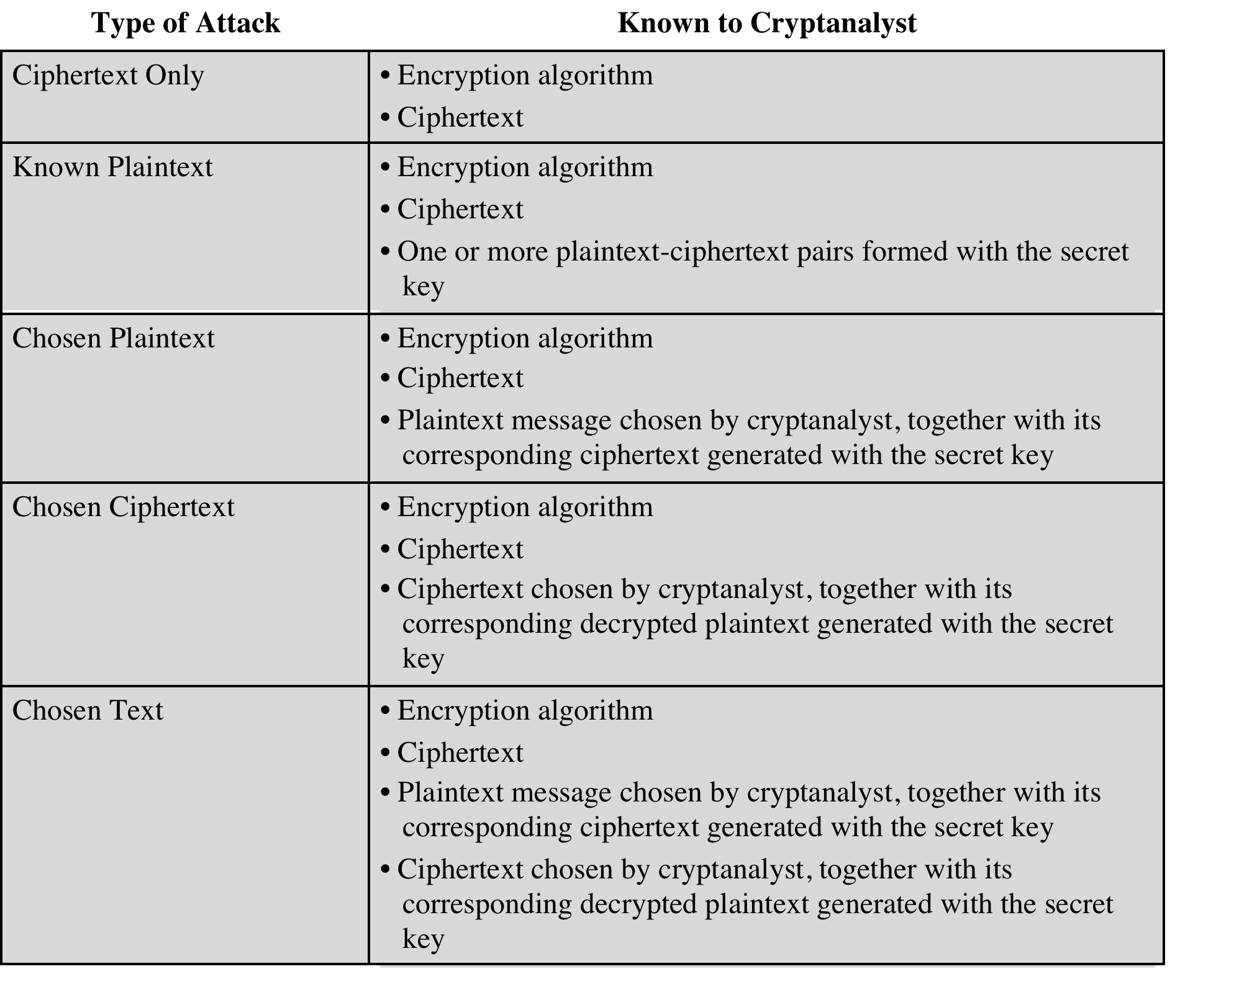

Slide 44
Encryption Systems
Symmetric (Private-key) Cryptosystem
A two-way channel to their users: A and B share a secret key, and they can both encrypt information to send to the other as well as decrypt information from the other.
Major difficulty: Key distribution. How do A and B obtain their shared secret key?
In general, n users who want to communicate in pairs need ? keys
Asymmetric (Public-key) Cryptosystem
Two separate keys
Public key for encryption
Private key for decryption
Key management is a major issue for both systems

Slide 45
Data Encryption Standard (DES)
In 1972 the U.S. National Bureau of Standards issued a call for proposals for producing a public encryption algorithm, with the following criteria:
Able to provide a high level of security
Specified and easy to understand
Publishable (security does not depend on the secrecy of the algorithm)
Available to all users
Adaptable for use in diverse applications
Economical to implement in electronic devices
Efficient to use
Able to be validated
Exportable
DES developed by IBM and accepted by ISO in 1976

Slide 46
DES (cont.)
A complex combination of two fundamental building blocks of encryption: substitution and transposition
The algorithm begins by encrypting the plaintext as blocks of 64 bits.
The key is 64 bits long, but in fact it can be any 56-bit number. (The extra 8 bits are often used as check digits and do not affect encryption in normal implementations.)
The algorithm accomplishes two things:
Ensuring that the output bits have no obvious relationship to the input bits (Substitution provides the confusion)
Spreading the effect of one plaintext bit to other bits in the ciphertext (Transposition provides the diffusion)

Slide 47
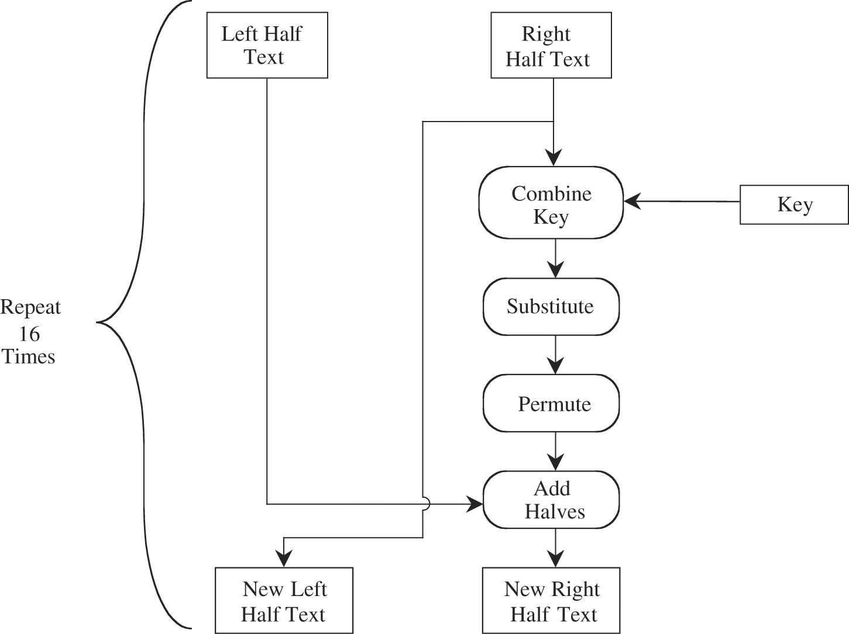
DES (cont.)
Plaintext is affected by a series of cycles of a substitution then a permutation.

Slide 48
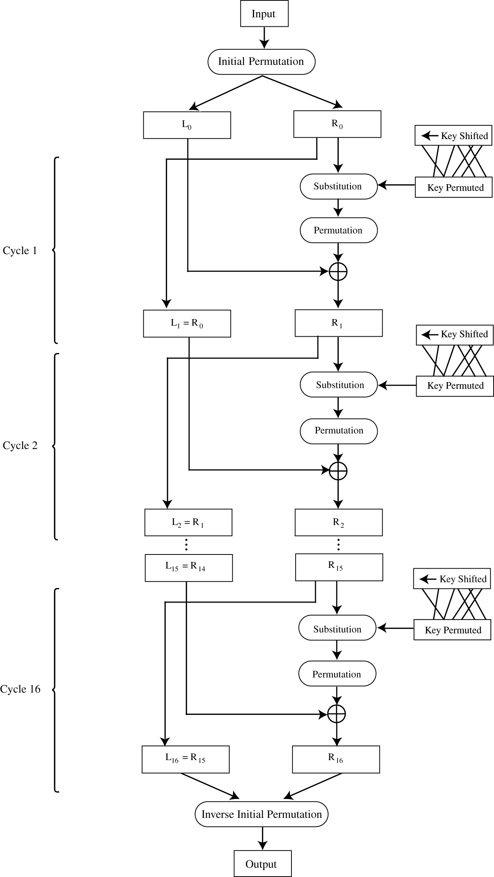
DES (cont.)
Steps
Input to the DES is divided into blocks of 64 bits.
The 64 data bits are permuted by a so-called initial permutation.
The data bits are transformed by a 64-bit key (of which only 56 bits are used).

Slide 49
DES (cont.)
Steps
The key is reduced from 64 bits to 56 bits by dropping bits 8, 16, 24, … 64 (where the most significant bit is named bit “1”). These bits are assumed to be parity bits that carry no information in the key.
Next begins the sequence of operations known as a cycle.
The 64 permuted data bits are broken into a left half and a right half of 32 bits each.

Slide 50
DES (cont.)
Steps
The key is shifted left by a number of bits and permuted.
The key is combined with the right half, which is then combined with the left half.
The result of these combinations becomes the new right half; the old right half becomes the new left half.
The cycles are repeated 16 times. After the last cycle is a final permutation, which is the inverse of the initial permutation.

Slide 51
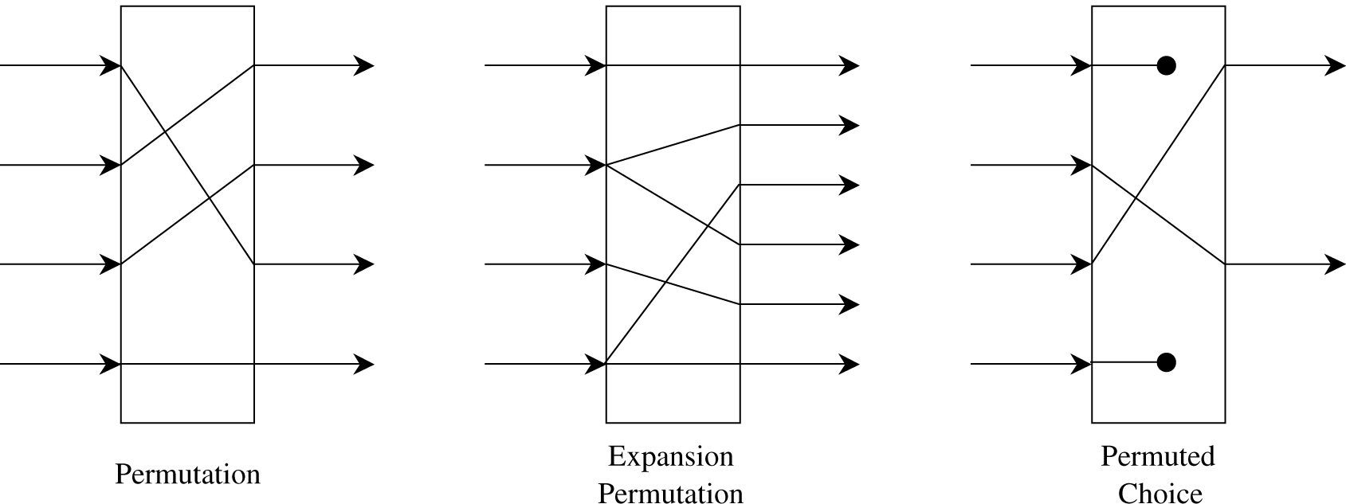
DES (cont.)
For a 32-bit right half to be combined with a 64-bit key, two changes are needed.
First, the algorithm expands the 32-bit half to 48 bits by repeating certain bits, while reducing the 56-bit key to 48 bits by choosing only certain bits. These last two operations, called expansion permutations and permuted choices

Slide 52
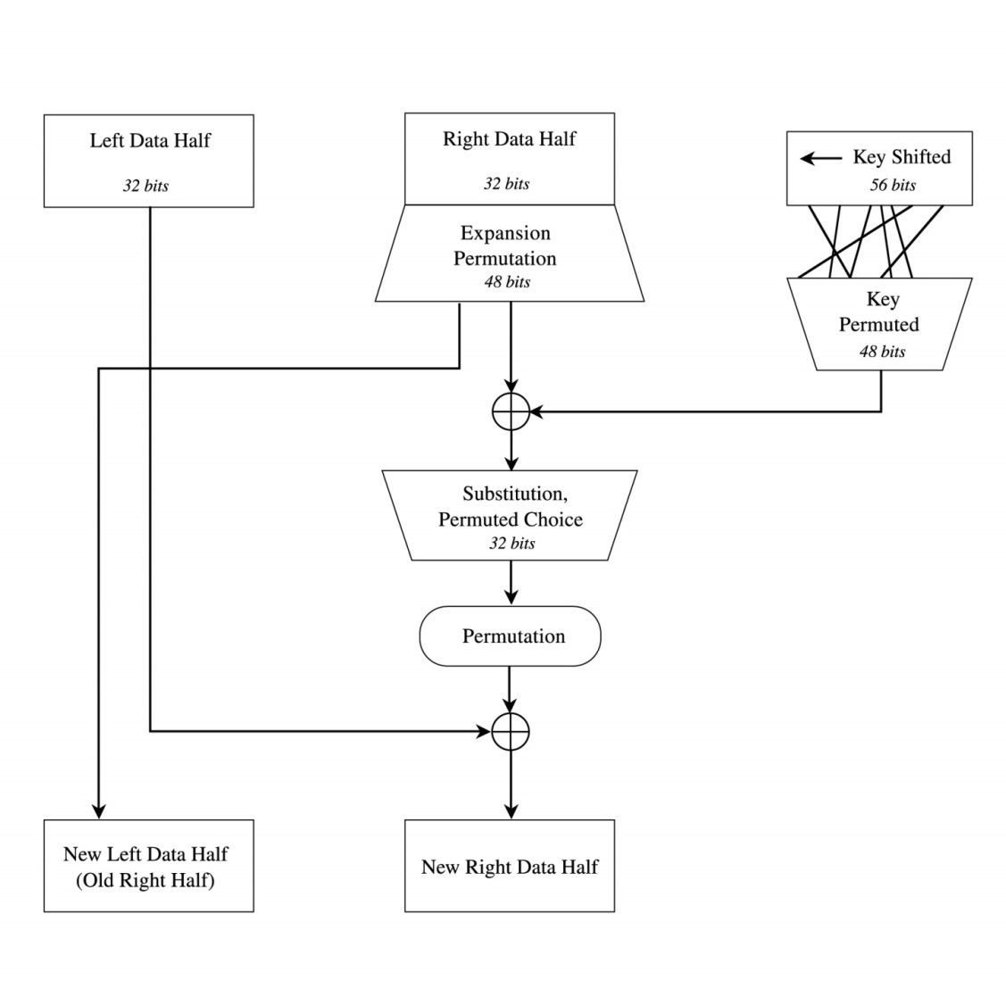
DES (cont.)
Details of Each Cycle of the Algorithm
The right half will be the left half of the next cycle.
The right half is expanded from 32 bits to 48.
Then, it is combined with a form of the key.

Slide 53
DES (cont.)
Details of Each Cycle of the Algorithm (cont.)
The result of this operation is then substituted for another result and condensed to 32 bits at the same time.
The 32 bits are permuted and then combined with the left half to yield a new right half.

Slide 54
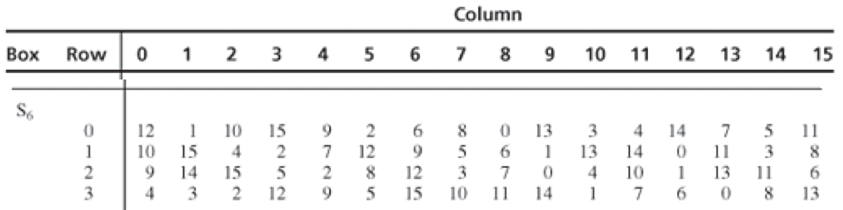
DES (cont.)
S-Boxes
Substitutions are performed by eight S-boxes.
An S-box is a permuted choice function by which six bits of data are replaced by four bits.
The 48-bit input is divided into eight 6-bit blocks, identified as B₁B₂... B₈; block B_{j} is operated on by S-box S_{j}.
The S-boxes are substitutions based on a table of 4 rows and 16 columns.

Slide 55
DES (cont.)
S-Boxes (cont.)
Suppose that block B_{j} is the six bits b₁b₂b₃b₄b₅b₆.
Bits b₁ and b₆, taken together, form a two-bit binary number b₁b₆, having a decimal value from 0 to 3. Call this value r.
Bits b₂, b₃, b₄, and b₅ taken together form a 4-bit binary number b₂b₃b₄b₅, having a decimal value from 0 to 15. Call this value c.
The substitutions from the S-boxes transform each 6-bit block B_{j} into the 4-bit result shown in row r, column c of section Si of S-Boxes table.

Slide 56
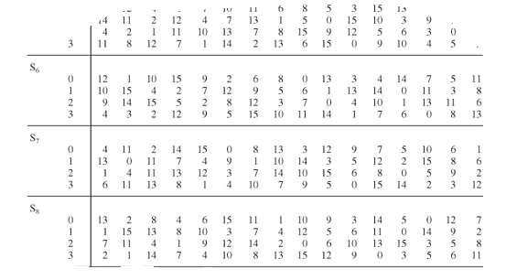
DES (cont.)
S-Boxes (cont.)
For example, assume that block B₇ in binary is 010011. Then, r = 01 = 1 and c = 1001 = 9. The transformation of block B₇ is found in row 1, column 9 of section 7 of Table 12-4. The value 3 = 0011 is substituted for the value 010011.

Slide 57
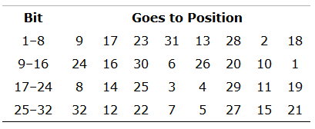
DES (cont.)
P-Boxes

Slide 58


DES (cont.)
Decryption of the DES
The same DES algorithm is used both for encryption and decryption.
This result is true because cycle j derives from cycle (j-1).
Keys must be taken in reverse order (k₁₆, k₁₅, ..., k₁)
Key shifts are applied in reverse
First Cycle of Encryption
First Cycle of Decryption

Slide 59
DES (cont.)
Security of DES
In 1990, Biham and Shamir showed that almost any change to the algorithm weakens it.
Their changes included
cutting the number of iterations from 16 to 15
changing the expansion or substitution rule
altering the order of an iteration.
In each case, when they weakened the algorithm, they could break the modified version.
Thus, it seems as if the design of DES is optimal.
Diffie and Hellman argued in 1977 that a 56-bit key is too short.
In 1997 researchers using over 3,500 machines in parallel were able to infer a DES key in four months’ work.
In 1998 for approximately $100,000, researchers built a special “DES cracker” machine that could find a DES key in approximately four days.

Slide 60
DES (cont.)
Double DES: using two keys
c = E(k₂ ,E(k₁ ,p))
Meet-in-the-Middle attack shows that actually Double DES gives a strength equivalent to a 57-bit key.
Triple DES: using three keys
c = E(k₃ ,D(k₂ ,E(k₁ ,p)))
It gives a strength equivalent to a 112-bit key (double DES attack defeats the strength of one of the three keys)
How about this:
c = E(k₁ ,D(k₂ ,E(k₁ ,p)))

Slide 61
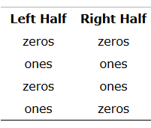
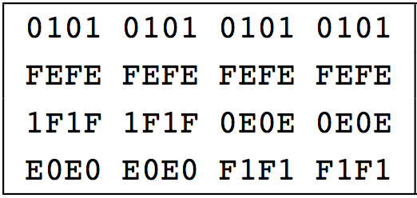
DES (cont.)
Weaknesses of the DES
Complements
If c = E(k, p) then ¬c = E(¬k, ¬p)
Weak Keys
Semi-weak Keys
Two different keys, k₁ and k₂, for which
c = E(k_{1,} p) and c = E(k_{2,} p)

Slide 62
Advanced Encryption Standard (AES)
In January 1997, NIST called for cryptographers to develop a new encryption system. The algorithms had to be
Unclassified
Publicly disclosed
Available royalty-free for use worldwide
Symmetric block cipher algorithms, for blocks of 128 bits
Usable with key sizes of 128, 192, and 256 bits
The winning algorithm, submitted by two Belgian cryptographers, was Rijndael.
The AES was adopted for use by the U.S. government in December 2001

Slide 63
AES (cont.)
The criteria for selection of the five finalists were
Security
Cost
Algorithm and implementation characteristics
It primarily uses
Substitution
Transposition
Shift, exclusive OR, and
Addition operations
Like DES, AES uses repeat cycles. There are 10, 12, or 14 cycles for keys of 128, 192, and 256 bits

Slide 64
AES (cont.)
A block cipher of block size 128 bits.
The key length can be 128, 192, or 256 bits.
A substitution-permutation cipher involving n rounds, where n depends on the key length.
For key length 128, 10 rounds are used
For 192, 12
For 256, 14
A 128-bit block is represented as a 4 × 4 matrix, “state”
State is shown as the matrix s[0,0],..., s[3,3].
The state is filled from the input in columns

Slide 65
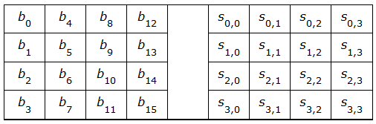
AES (cont.)
Example:
Input: 16 bytes b₀, b₁, b₂, b₃,..., b₁₅. These bytes are then represented in the state as the following table
Some operations are performed on columns of the state, and some on rows

Slide 66
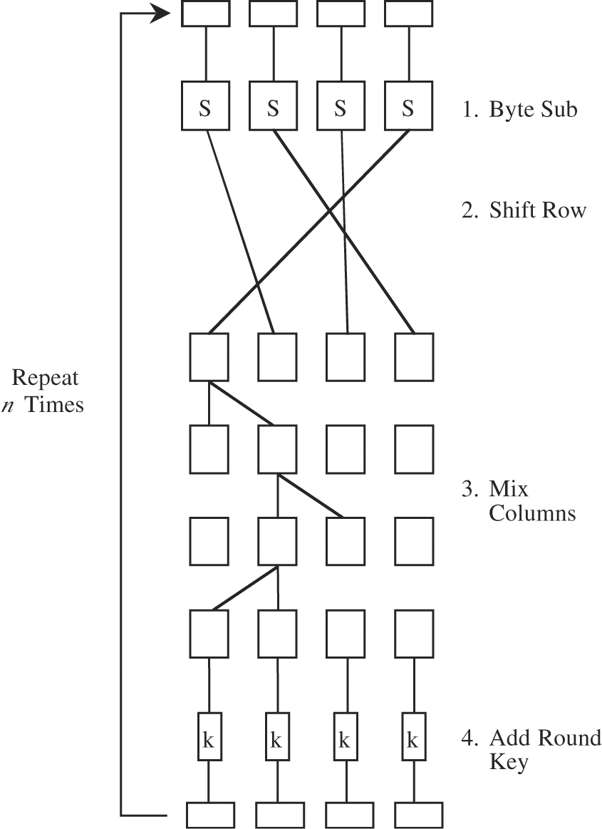
AES (cont.)
Each cycle consists of four steps.
Byte substitution: Using S-Boxes substituting each byte of a 128-bit block according to a substitution table. (diffusion)

Slide 67
AES (cont.)
Each cycle consists of four steps.
Shift row: A transposition step.
For 128- and 192-bit block sizes, row n is shifted left circular (n - 1) bytes
For 256-bit blocks, row 2 is shifted 1 byte and rows 3 and 4 are shifted 3 and 4 bytes, respectively. (confusion)

Slide 68
AES (cont.)
Each cycle consists of four steps.
Mix column: Shifting left and XORing bits with themselves. (both confusion and diffusion)

Slide 69
AES (cont.)
Each cycle consists of four steps.
Add subkey: A portion of the key unique to this cycle is XORed with the cycle result. (confusion and incorporating the key)

Slide 70
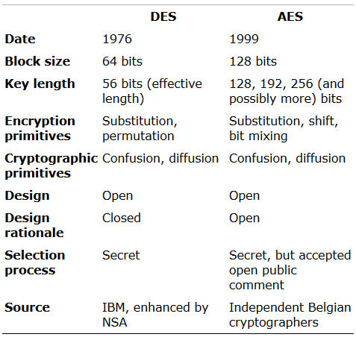
Comparison of DES and AES

Slide 71
Mathematics
Greatest Common Divisor (GCD)
GCD of two integers, is the largest positive integer that divides the numbers without a remainder
Euclidean Algorithm
(define (gcd a b)
(if (= b 0)
a
(gcd b (remainder a b))))
Modular Arithmetic
Computing Inverses
For any prime p and any element a < p , the inverse of a is an element x such that:
ax mod p = 1
Fermat’s Theorem
For any prime p and any element a < p :
a ^{p-1} mod p = 1

Slide 72
Public Key Encryption Systems
Characteristics
Each user has two keys: a public key and a private key.
The user may publish the public key freely.
Let k_{priv} be a user’s private key, and let k_{pub} be the corresponding public key. Then,
p=D(k_{priv} ,E(k_{pub} ,p))
i.e. a user can decode with a private key what someone else has encrypted with the corresponding public key.
Furthermore, with the second public key encryption algorithm,
p=D(k_{pub} ,E(k_{priv} ,p))
i.e. a user can encrypt a message with a private key and the message can be revealed only with the corresponding public key (digital signature).

Slide 73
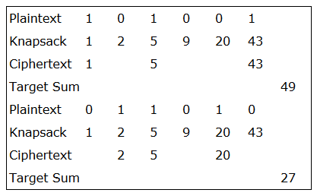
Merkle–Hellman Knapsacks
Encode a binary message as a solution to a knapsack problem, reducing the ciphertext to the target sum obtained by adding terms corresponding to 1s in the plaintext.
The knapsack problem is NP-complete, implying that to solve it probably requires time exponential in the size of the problem—in this case, the number of integers.

Slide 74
Merkle–Hellman Knapsacks (cont.)
The algorithm begins with a knapsack set, each of whose elements is larger than the sum of all previous elements.
General Knapsacks:
Examines a sequence a₁, a₂, …, a_{n} of integers and a target sum, T. The problem is to find a vector of 0s and 1s such that the sum of the integers associated with 1s equals T. That is, given S = [a₁,a₂, …, a_{n}], and T, find a vector V of 0s and 1s such that

Slide 75
Merkle–Hellman Knapsacks (cont.)
Example:
[17,38,73,4,11,1] and the target number 53. The problem is
73 cannot be a term, so we can ignore it.
Trying 17, the problem reduces to finding a sum for
(53 - 17 = 36)
With a second target of 36, 38 cannot contribute, and 4 + 11 + 1 are not enough to make 36.
We then conclude that 17 is not a term in the solution.
If 38 is in the solution, then the problem reduces to the new target
(53 - 38 = 15)
With this target, the remaining values show that 4 and 11 complete the solution, since 4 + 11 = 15.
A solution is thus 38 + 4 + 11.
With many integers, it would have been much more difficult to find a solution, especially if they were all of similar magnitude so that we could not dismiss any immediately.

Slide 76
Merkle–Hellman Knapsacks (cont.)
Super-increasing Knapsacks
An additional restriction on the problem
The integers of S must form a super-increasing sequence, that is, one where each integer is greater than the sum of all preceding integers. Then, every integer a_{k} would be of the form
In the previous example, [1,4,11,17,38,73] is a super-increasing sequence.
The solution of a super-increasing knapsack (also called a simple knapsack) is easy to find.

Slide 77
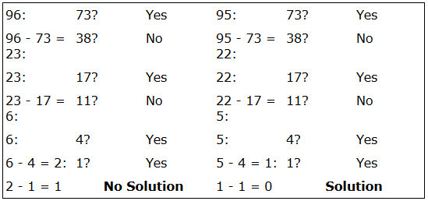
Merkle–Hellman Knapsacks (cont.)
Example

Slide 78
Merkle–Hellman Knapsacks (cont.)
The Knapsack Problem as a Public Key Cryptographic Algorithm
The public key is the set of integers of a knapsack problem (a hard knapsack).
The private key is a corresponding super-increasing knapsack (a simple knapsack).
The contribution of Merkle and Hellman was the design of a technique for converting a super-increasing knapsack into a regular one.
The trick is to change the numbers in a nonobvious but reversible way.
We need a super-increasing knapsack that we can transform into a hard knapsack.

Slide 79
Merkle–Hellman Knapsacks (cont.)
After selecting a simple knapsack S = [s₁, s₂,…,s_{m}], we choose a multiplier w and a modulus n.
The modulus, n, should be a number greater than the sum of all s_{i} .
The multiplier, w, should have no common factors with the modulus n.
One easy way to guarantee this property is to choose a modulus that is a prime number, since no number smaller than it will have any common factors with it.
Finally, we replace every integer s_{i} in the simple knapsack with the term
h_{i} = w * s_{i} mod n
Then, H = [h₁, h₂,…, h_{m}] is a hard knapsack.

Slide 80
Merkle–Hellman Knapsacks (cont.)
Example:
A super-increasing knapsack S = [1, 2, 4, 9]
Transform it by multiplying by w and reducing mod n where
w = 15 and n = 17
1 * 15 = 15 mod 17 = 15
2 * 15 = 30 mod 17 = 13
4 * 15 = 60 mod 17 = 9
9 * 15 = 135 mod 17 = 16
The hard knapsack derived in this example is
H = [15, 13, 9, 16]

Slide 81
Merkle–Hellman Knapsacks (cont.)
Example (cont.) :
Encryption of the message: P = 0100101110100101
[0, 1, 0, 0] * [15, 13, 9, 16] = 13
[1, 0, 1, 1] * [15, 13, 9, 16] = 40
[1, 0, 1, 0] * [15, 13, 9, 16] = 24
[0, 1, 0, 1] * [15, 13, 9, 16] = 29
The message is encrypted as the integers c=13, 40, 24, 29
Decryption of c=13, 40, 24, 29
Computing w⁻¹ mod n
15 * 8 mod 17 = 120 mod 17 = (17 * 7) + 1 mod 17 = 1
P_{i} = w⁻¹ * c_{i}
13 * 8 = 104 mod 17 = 2 = [0100]
40 * 8 = 320 mod 17 = 14 = [1011] using S = [1, 2, 4, 9]
24 * 8 = 192 mod 17 = 5 = [1010]
29 * 8 = 232 mod 17 = 11 = [0101]
P = 0100101110100101

Slide 82
Merkle–Hellman Knapsacks (cont.)
Weakness
An interceptor does not have to solve the basic knapsack problem to break the encryption
The encryption depends on specially selected instances of the problem.
In 1980, Shamir found that if the value of the modulus n is known, it may be possible to determine the simple knapsack (private key).
A more serious flaw was identified later by Shamir in 1982.
The approach tries to deduce w and n from the h_{i} (public key) alone.

Slide 83
Rivest–Shamir–Adelman (RSA) Encryption
Introduced in 1978 by Rivest, Shamir, and Adelman.
It operates with arithmetic mod n.
Two keys, d and e, are used for decryption and encryption, which are interchangeable.
The plaintext block p is encrypted as
c = p^{e} mod n
The exponentiation is performed mod n
Thus factoring p^{e} to uncover the encrypted plaintext is difficult
Decrypting is done as
p = c^{d} mod n
Legitimate receiver who knows d simply computes p and recovers it without having to factor p^{e}.

Slide 84
Rivest–Shamir–Adelman (RSA) Encryption
p = c^{d} mod n = (p^{e})^{d} mod n = (p^{d})^{e} mod n
One can apply the encrypting transformation and then the decrypting one, or vise versa.
Encryption (public) key consists of the pair of integers (e, n)
Decryption (private) key is (d, n).

Slide 85
Rivest–Shamir–Adelman (RSA) Encryption
Steps
Selecting a value for n. The value of n should be quite large, a product of two primes p and q.
Typically, p and q are nearly 100 digits each, so n is approximately 200 decimal digits (about 512 bits) long
768, 1024, or more bits may be more appropriate.
Next, a relatively large integer e is chosen so that e is relatively prime to (p - 1) * (q - 1).
An easy way to guarantee that e is relatively prime to (p - 1) * (q - 1) is to choose e as a prime that is larger than both (p - 1) and (q - 1).
Finally, select d such that e * d = 1 mod (p - 1) * (q - 1)

Slide 86
Rivest–Shamir–Adelman (RSA) Encryption
Mathematical Foundations of the RSA Algorithm
The Euler’s totient function φ(n) is the number of positive integers less than n that are relatively prime to n. If p is prime, then
φ(p) = p - 1
Furthermore, if n = p * q, where p and q are both prime, then
φ(n) = φ(p) * φ(q) = (p - 1) * (q - 1)
Euler and Fermat proved that
x^{φ(n)} ≡ 1 mod n
for any integer x if n and x are relatively prime.

Slide 87
Rivest–Shamir–Adelman (RSA) Encryption
Example
Let p = 61 and q = 53, so that n = p * q = 3233 and φ(n) = 3120.
Next, an integer e is needed, and e must be relatively prime to (p - 1) * (q - 1). Choose e = 17.
The inverse of 17 mod 3120 is d=2753.
Let P = 65.
The message is encrypted as follows:
65¹⁷ mod 3233 = 2790, so that E(65) = 2790.
D(2790) = 2790²⁷⁵³ mod 3233 = 65.

Slide 88
Rivest–Shamir–Adelman (RSA) Encryption
Cryptanalysis
RSA-140 (463 bits), was factored in 1999 in 1 month using approximately 200 machines.
RSA-155 (512 bits) was factored in 1999 in approximately 3.7 months using 300 machines.
RSA-160 was factored in 2003 in only 20 days
RSA-200 (663 bits) was factored in 2005 after about 18 months, using an unspecified number of machines
1024 or longer bit keys are still secure enough to use

Slide 89
The El Gamal Cryptosystem
Introduced in 1984 by El Gamal
Relies on the difficulty of computing discrete logarithms over finite fields.
Because it is based on arithmetic in finite fields, as is RSA, it has some similarity to RSA.
It is of considerable importance in the U.S. Digital Signature Standard (DSS).
For a given plaintext P, the generated ciphertext has two separate parts, c₁ and c₂ .

Slide 90
Digital Signature
A digital signature is, like a handwritten signature
A means of associating a mark unique to an individual with a body of text.
The mark should be unforgeable, meaning that only the originator should be able to compute the signature value.
The mark should be verifiable, meaning that others should be able to check that the signature comes from the claimed originator
The general way of computing digital signatures is with public key encryption
The signer computes a signature value by using a private key.
Others can use the public key to verify that the signature came from the corresponding private key.

Slide 91
The El Gamal Signature Algorithm
Key generation
First choose a prime p and two integers, a and x, such that a < p and x < p and calculate
y = a^{x} mod p
a should be a generator of GF(p).
The prime p should be chosen so that (p - 1) has a large prime factor, q.
The private key is (x,p,a)
The public key is (y,p,a).

Slide 92
The El Gamal Signature Algorithm
To sign a message m
Choose a random integer k, 0 < k < p - 1, which has not been used before and which is relatively prime to (p - 1)
Compute r = a^{k} mod p
Compute s = k⁻¹ (m – x r) mod (p - 1)
where k⁻¹ is the multiplicative inverse of k mod (p - 1)
The message signature is then (r,s).
To verify the signature
Use the public key y to compute y^{r} r^{s} mod p and determine that it is equivalent to a^{m} mod p.

Slide 93
The El Gamal Signature Algorithm
Example
Key generation
p=23, a=5, x=3, y = a^{x} mod p = 5³ mod 23 = 10
Sign the message m= 8
Select k=5 k⁻¹ = 5⁻¹ = 9 (59=45=1 mod 22)
Compute
r = a^{k} mod p = 5⁵ mod 23 = 20
Compute
s = k⁻¹ (m - xr) mod (p - 1) = 5⁻¹ (8 – 320) mod 22 = 914 mod 22 = 16
Signature verification
y^{r} r^{s} mod p = 10²⁰ * 20¹⁶ mod 23 = 3 * 13 mod 23 = 16
a^{m} mod p = 5⁸ mod 23 = 16

Slide 94
The El Gamal Signature Algorithm
The U.S. Digital Signature Algorithm (DSA) (or the Digital Signature Standard or DSS) is the El Gamal algorithm with a few restrictions:
The size of p is specifically fixed at 2⁵¹¹ < p < 2⁵¹² (roughly 170 decimal digits long)
q, which is the large prime factor of (p - 1) is chosen so that 2¹⁵⁹ < q < 2¹⁶⁰
The algorithm explicitly uses H(m), a hash value, instead of the full message text m
The computations of r and s are taken mod q.

Slide 95
Secret Sharing
Sharing a secret among a group of participants.
It was introduced by Adi Shamir and George Blakley in 1979, independently.
The secret can be reconstructed only when a sufficient number (called threshold) of shares are participated in the decryption process.
It is shown by (t,n)-threshold, in which n is the total number of participants and t is the minimum number of required participants for secret reconstruction.
Any combination of fewer than t shares has no extra information about the secret than that with no share.
Its applications include, but not limited to,
Encryption keys distribution
Missile launch codes
Bank accounts
Bank safe-deposit boxes

Slide 96
Secret Sharing (cont.)
Limitations to all unconditionally secure secret sharing schemes:
Each share of the secret must be at least as large as the secret itself.
Based on information theory, given t-1 shares, no information can be revealed from the secret. Thus, the shares must contain as much information as the secret itself.
All secret sharing schemes use random bits.
To distribute a one-bit secret among t participants, t-1 random bits are necessary.

Slide 97
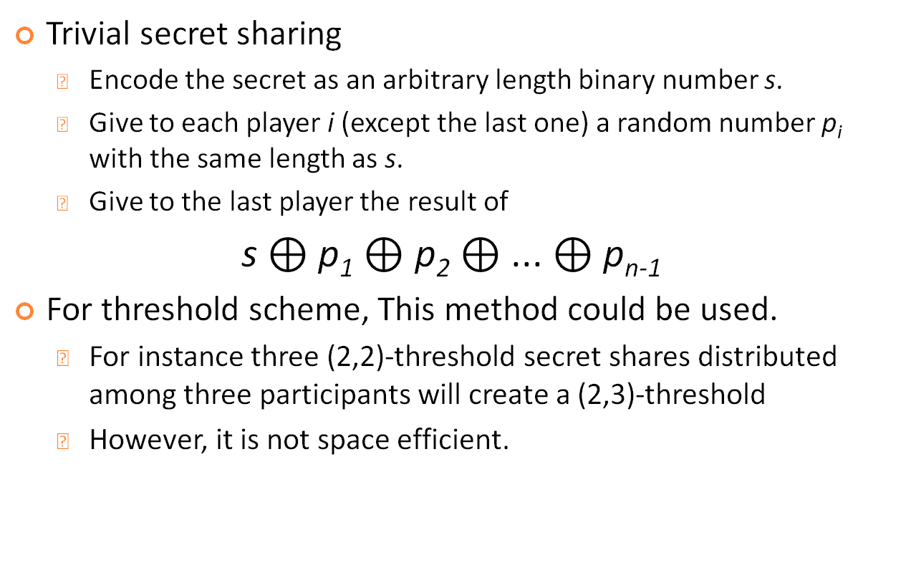
Secret Sharing (cont.)
Trivial secret sharing
Encode the secret as an arbitrary length binary number s.
Give to each player i (except the last one) a random number p_{i} with the same length as s.
Give to the last player the result of
s $⊕$ p₁ $⊕$ p₂ $⊕$ ... $⊕$ p_{n-1}
For threshold scheme, This method could be used.
For instance three (2,2)-threshold secret shares distributed among three participants will create a (2,3)-threshold
However, it is not space efficient.

Slide 98
Secret Sharing (cont.)
Shamir's Secret Sharing Scheme
We can fit a unique polynomial of degree (t-1) to any set of t points that lie on the polynomial.
For instance, two points are needed to define a straight line, and three points to define a quadratic
In general it takes t points to define a polynomial of degree t-1.
Method:
Create a polynomial of degree t-1
Set the secret as the first coefficient
The remaining coefficients are selected at random
Select n points on the curve as the shares
It is sufficient that at least t out of the n participants use their shares to fit a (t-1) degree polynomial to them
The first coefficient would be the secret.

Slide 99
Secret Sharing (cont.)
Shamir's Secret Sharing Scheme (cont.)
Example
Secret = 1234 , n = 6, and t = 3
Shares construction
Randomly select (t-1) = 2 numbers, say, a₁ = 166 and a₂ = 94.
The polynomial would be
f(x)=1234+166x+94x²
Construct 6 points (shares) from the polynomial:
(1,1494),(2,1942),(3,2578),(4,3402),(5,4414),(6,5614)
and distribute them among the participants.

Slide 100
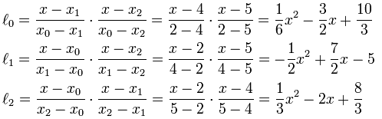



Secret Sharing (cont.)
Secret reconstruction
Select any three shares, say
(2,1942),(4,3402),(5,4414)
Use a polynomial interpolation method, such as Lagrange, to find the coefficients of the polynomial
Secret would be the constant value of the polynomial
$$→$$
$$→$$

Slide 101
Secret Sharing (cont.)
Proactive Secret Sharing
It is a method to periodically update the secret shares.
Attacker has less time to compromise the shares
Example for Shamir style
By the dealer
Create a new polynomial with zero for the constant value
Send the new shares to the participants
Participants will add their old and new shares to have new ones
By the participants
Each participant creates a random polynomial with zero constant value
Each participant evaluate their polynomial and send some information to the other participants
Participants update their shares by adding their old and new computed and received information

Slide 102
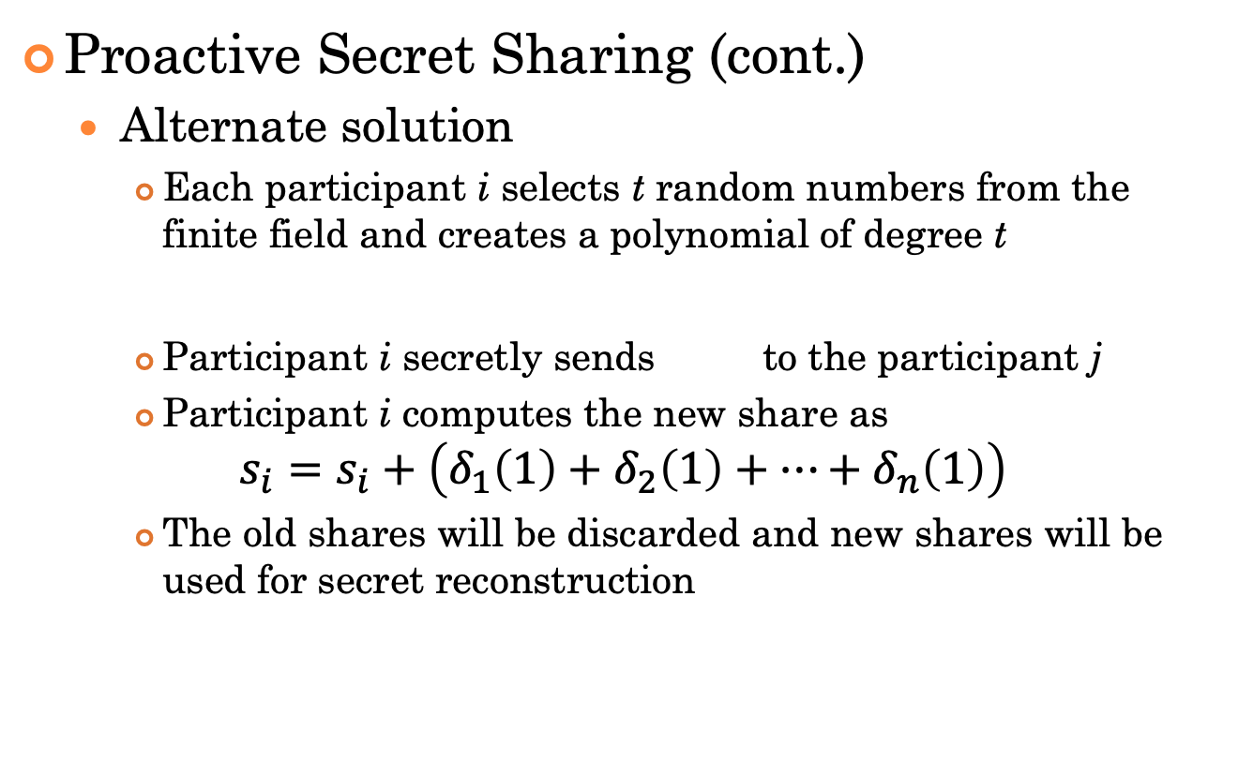
Secret Sharing (cont.)
Proactive Secret Sharing (cont.)
Alternate solution
Each participant i selects t random numbers from the finite field and creates a polynomial of degree t
Participant i secretly sends to the participant j
Participant i computes the new share as
$$s_{i}=s_{i}+\left(δ_{1}\left(1\right)+δ_{2}\left(1\right)+…+δ_{n}\left(1\right)\right)$$
The old shares will be discarded and new shares will be used for secret reconstruction

Slide 103
Secret Sharing (cont.)
Verifiable Secret Sharing
The shares dealer or one or more participants could be malicious and alter the shares during shares distribution or reconstruction phase
Players are able to check the consistency of their shares
Feldman’s scheme
Select a generator, g, from a cyclic group, G, of a prime order, p
For the polynomial
Compute and send among the shares to the participants
Each participant can verify the following equation
Some information can be learned from c_{i}’s .

